Slide 1
CSE 6040/x Programming Skills Office Hours
Week 4, Session 1

Slide 2
Agenda for This Week
Session 1
Higher order functions / Properties of slices / Problem solving example: Longest consecutive subsequences – Prof Vuduc video, 09-20: Sample problem: Longest consecutive subsequences, the entire video, 1:13:47 at 1.25x speed (59 minutes runtime).
NBA Data sample exercises
Nested data troubleshooting concepts
Session 2
Prof Vuduc Walkthrough of PMT1 Practice problem 21 – video, 09-22 — pmt1.21 (caption contest), from 10:00 to the end (1:13, 63 minutes) at 1.25x speed (50 minutes runtime).
Prof Vuduc Walkthrough of PMT1 Practice problems 16/9/2 – video, 09-27 — pmt1.16, pmt1.9, pmt1.2, entire video (stop at 1:10, 70 minutes) at 1.25x speed (47 minutes runtime, with skips)
Skips from 4:30-10:00 and 19:10-26:00

Slide 3
Advanced Nested Data (NBA example)
Why so much emphasis on nested data structures?
Let’s look at the notebooks leading up to MT1
NB 1 – Intro to variables and nesting (student grades)
NB 2 – Association rule mining (in a nested data structure)
NB 4 – Underlying number data storage (numbers as strings in a complex data structure)
NB 5 – String manipulation/regex (in a complex and nested HTML data structure)
What is the common theme here?
We are doing more complex coding, within the framework of the data structure.
So, we must understand how to address the underlying data structures, in order to perform the required operations/manipulations.
With practice, directly addressing each element of the data structure should become “2nd nature”, so that you can focus on the data manipulations of the exercise requirements.

Slide 4
Nested Data -- 2
As we move forward in the course, the emphasis will go from basic data manipulations to applying these techniques to solve “real world” data scenarios.
You will need to understand which data structures are being used and how to manipulate them.
With practice, directly addressing each element of the data structure must become “2nd nature”, so that you can focus on the algorithmic/logic requirements of the exercises.
So, what we want to do is provide you with some tools and techniques to help understand how to read, understand, and work with nested data structures.

Slide 5
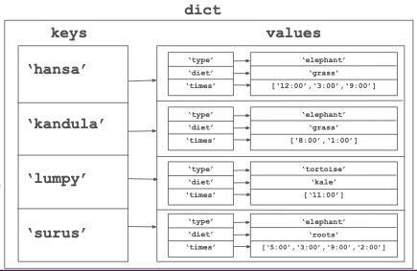
Troubleshooting Nested Data
Don’t try to print the whole data (it might be large)
Use diagnostic functions like len(), type() to understand the structure of the nested data
Usually, the nested data is logically structured. We recommend you create a mental map of how the data is organized - It will enable you to write code and extract the required data easily
Drop it into Python Tutor to visualize.
Develop the syntax of addressing each individual element of the data structure.

Slide 6
Open Discussion / Q&A

